Slide 1

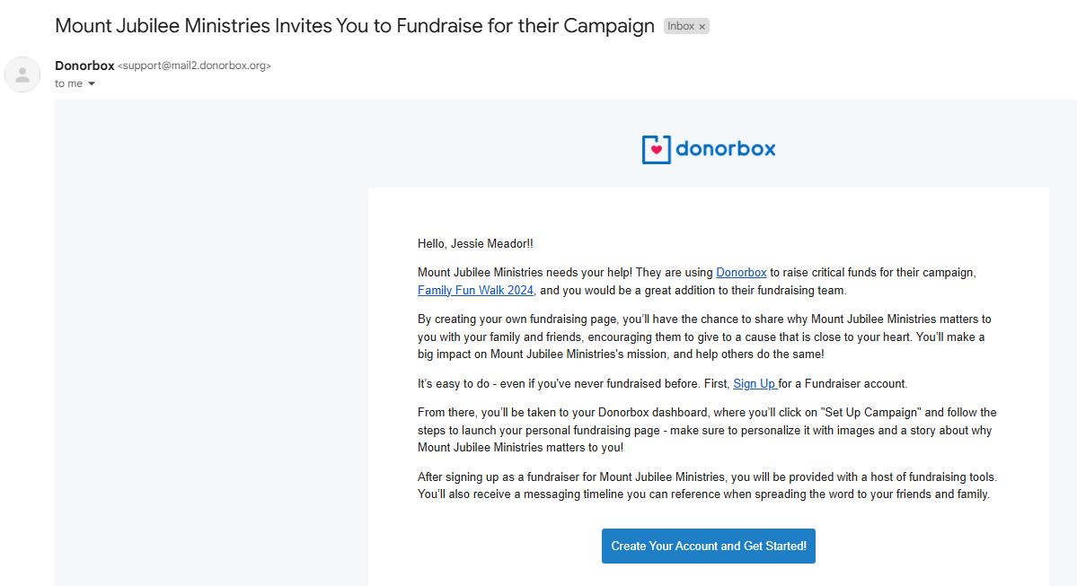
2024 Family Fun Walk Team Registration
Step-by-Step Instructions
1) First, you will receive an email from “Donorbox” inviting you to join the Mount Jubilee Ministries campaign. Click and open the email:
2) Once you open the email, click the button that reads “Create Your Account and Get Started” at the bottom of the page:

Slide 2
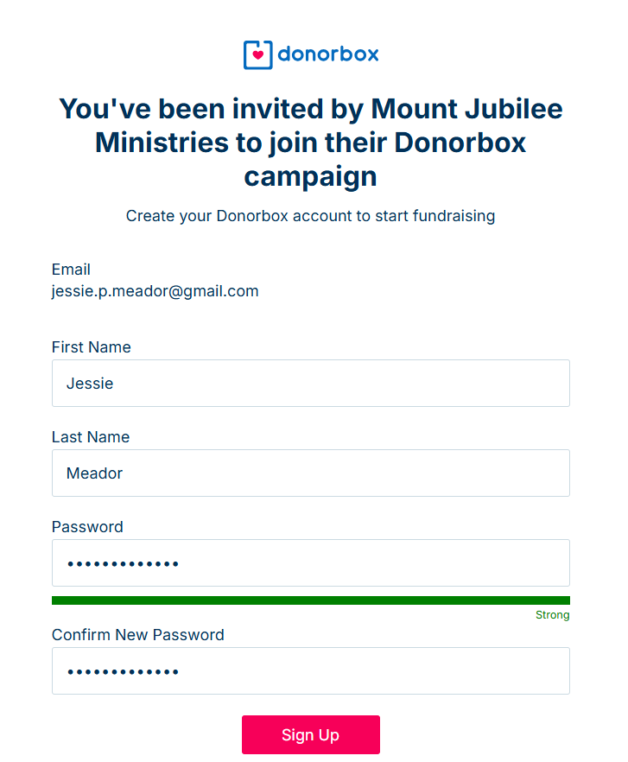
3) Fill in your information and create a password. Click “Sign Up” in red:

Slide 3
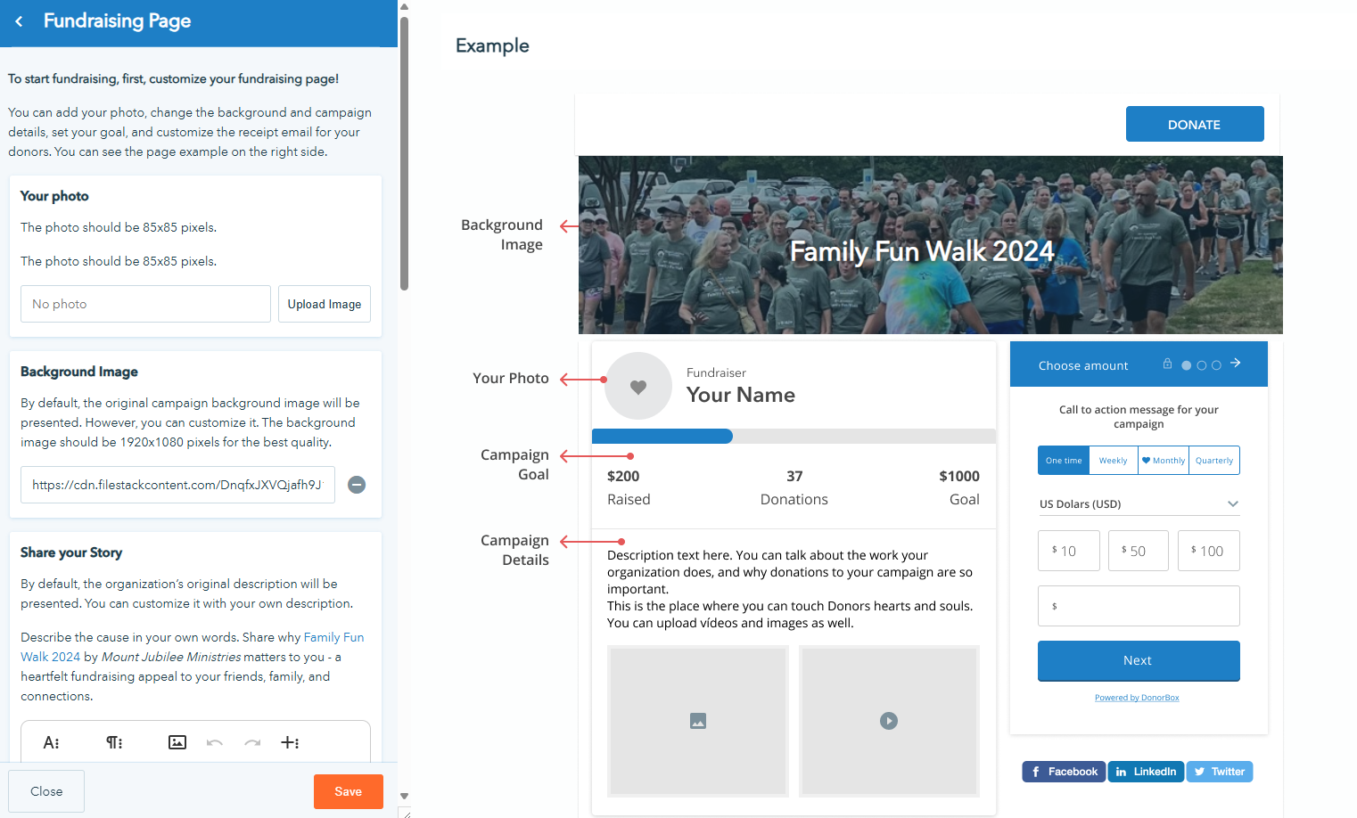
4) Once logged in, you will join the Family Fun Walk 2024 campaign by clicking “Accept Invitation” on the right, top corner of the screen:
5) Next you will see your Team customization page. On the left side, you will see where you can edit settings, wording, and photos. On the right of the page, you will see a preview of the inputs. Some update as you edit, and some do not.
Area for customization Page Preview Area

Slide 4
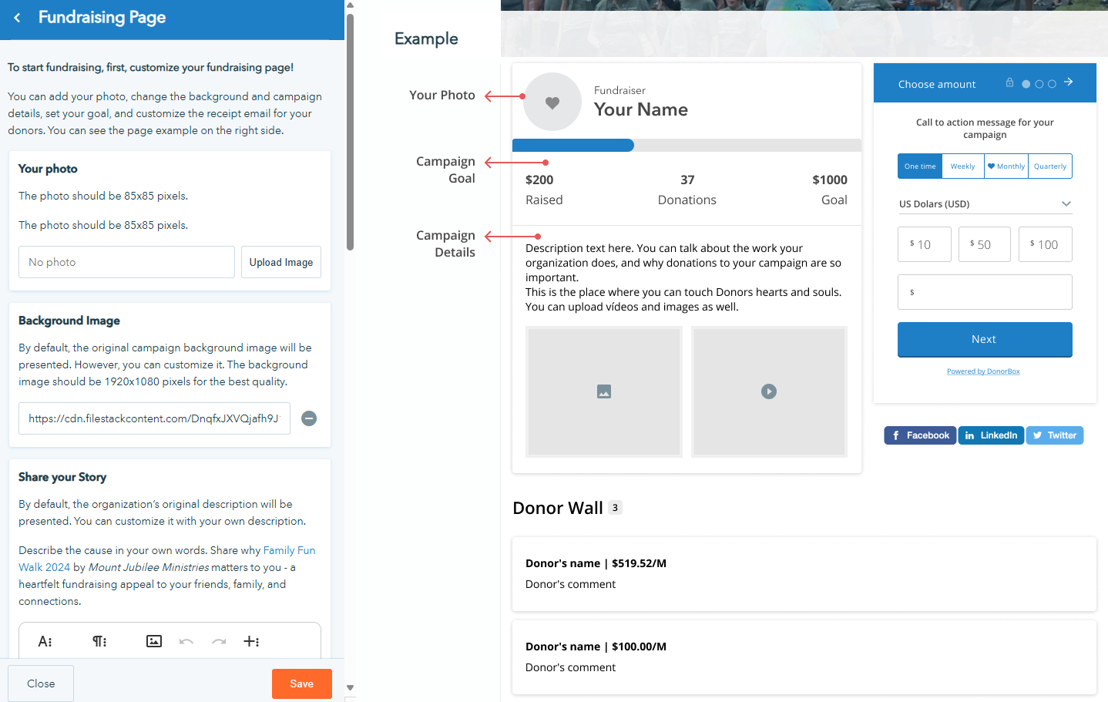
6) We suggest you make the following edits to the Fundraising page by scrolling down the left side of the customization area of the page:
  Your photo – upload a smiling picture so your friends and family recognize you!
  Share Your Story – Why are you passionate about fundraising for Mount Jubilee Ministries?
  Campaign goal – We encourage you to make your goal at least the individual goal of $2353. And of course, more if you feel so led!
7) Once all your customizations are complete, be sure to click the orange “Save” button at the bottom of the screen.

Slide 5
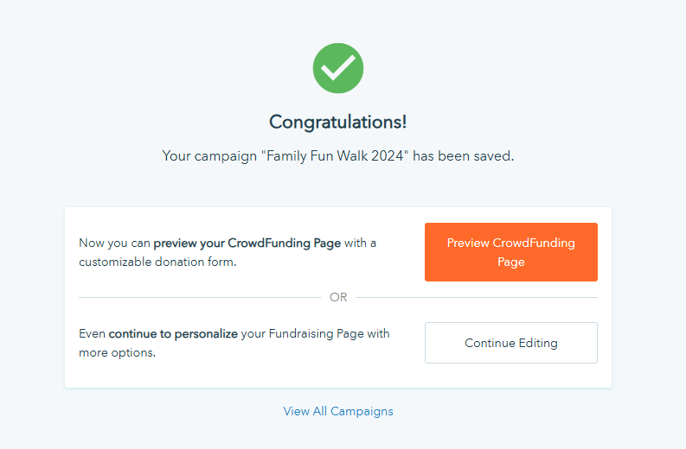
8) Once you hit the save button, a new page opens telling you that you completed registration:
9) If you click on “Preview CrowdFunding” page, it will open a new tab. You can copy and paste the webpage URL from the top of the page.
You can also click “View All Campaigns”, and then click on “Family Fun Walk 2024” to see your progress and copy your URL from there. Use that link to share on social media and to email or text to friends & family!
***PLEASE NOTE***
If you have any issues getting registered, please call the MJM Office at (336) 813-2034 for troubleshooting assistance.

